Slide 1
Rental ERP
Zaeem Solutions

Slide 2
Introduction
This document details the features and functionalities of Rental ERP.
An ERP solution designed for rental management companies to handle the day-to-day operations such as
Rental Management
Fleet Management
Accounting
Sales
Purchase
Inventory Management
This document has further divided into two sections
Reports
Operations

Slide 3
Fleet Accountant
Create Vehicle models
Create Accessories
Create Product Vehicle Category
Create vendors
Purchase Vehicles
Receive Vehicles in inventory
Generate Vendor bills
Manage asset and loan
Vehicle Registration
Approve Vehicles
Create customers/Drivers
Create & send quotations
Confirm orders

Slide 4
Confirm contract
Mark fuel level odometer readings and damages in vehicle return
Create & validate invoices
Close rentals
Manage sales team
Request/ service Maintenance
Mark Damages & capture additional expenses occurred by customer
Close Rentals
Approve Vehicle Registration
Manage Sales team
Lock & Unlock Rental Orders
All accounting operations
Create & approve PO

Slide 5
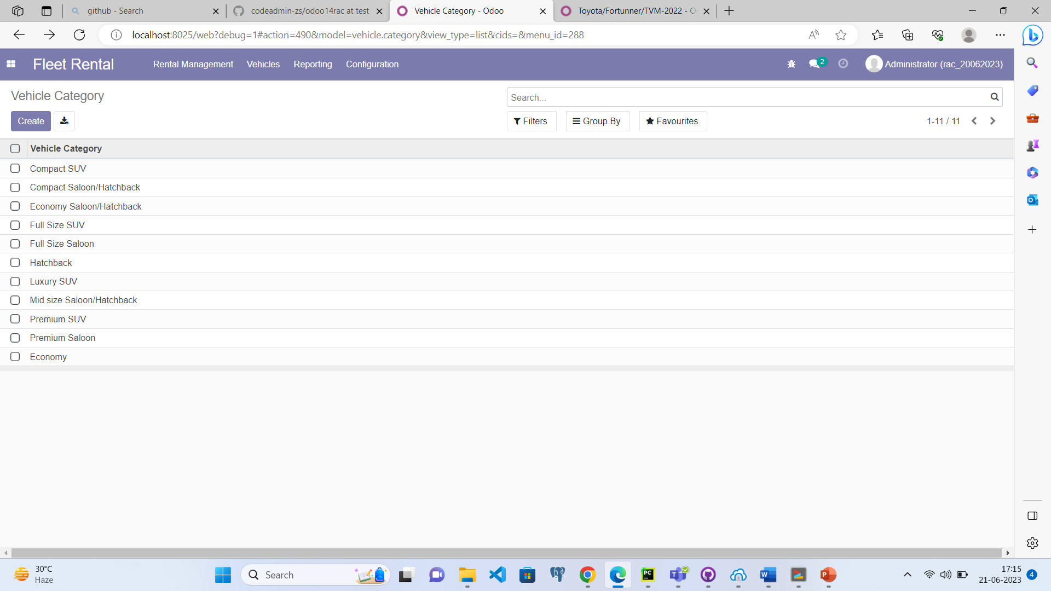
Create Product Vehicle Category(optional)
Menu
Fleet Rental -> Configuration -> Vehicle Category
General Information
Vehicle Categories can be created by Clicking the create button

Slide 6
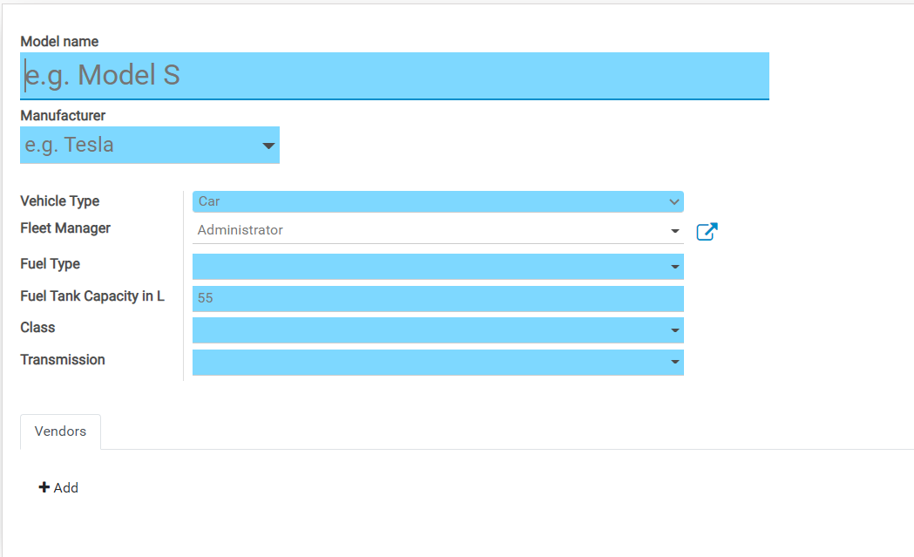
Create Vehicle Models(optional)
Menu
Fleet Rental -> Configuration -> vehicles Model
Enter Model Name
Select “ Manufacturer”
Select Vehicle Type, Fuel Type, Fuel Tank Capacity, class and Transmission

Slide 7
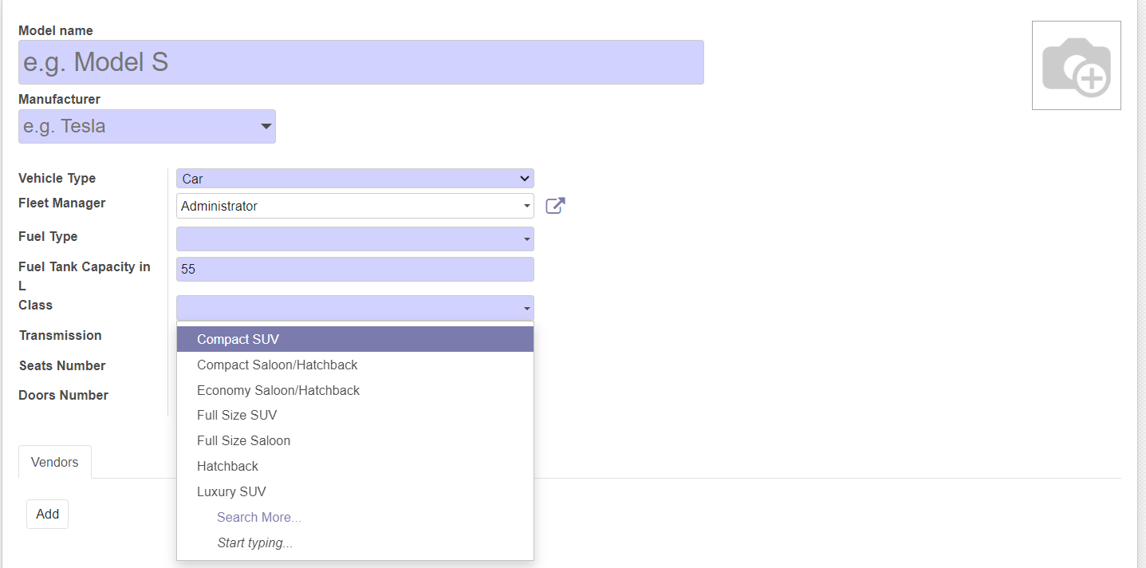
Create Vehicle Models
When click on the class it shows product vehicle category

Slide 8
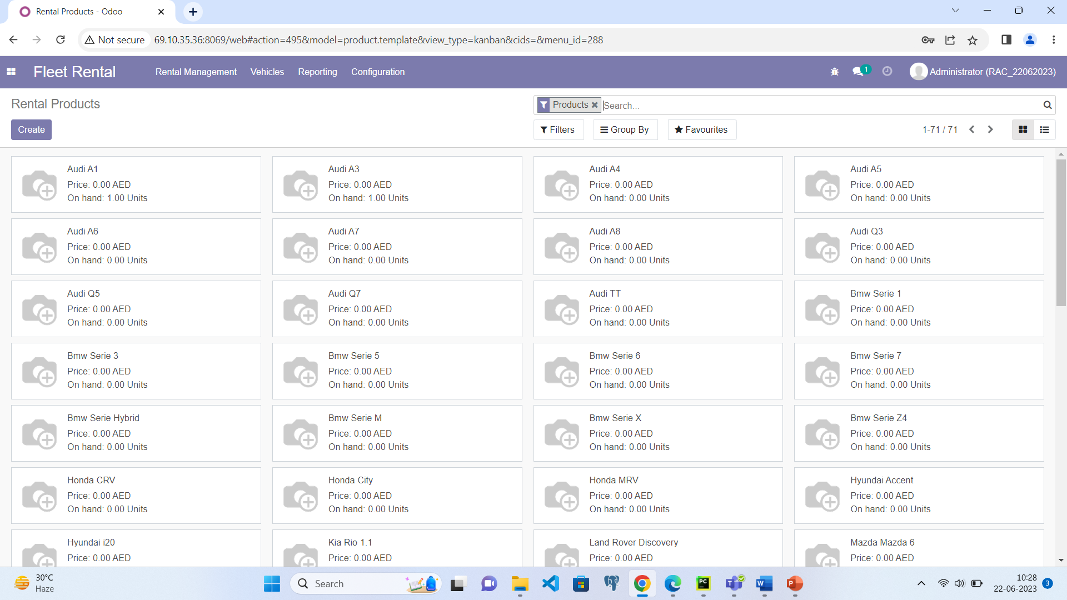
Rental Products
Menu
Fleet Rental -> Configuration -> Rental Products
Created vehicle models list here

Slide 9
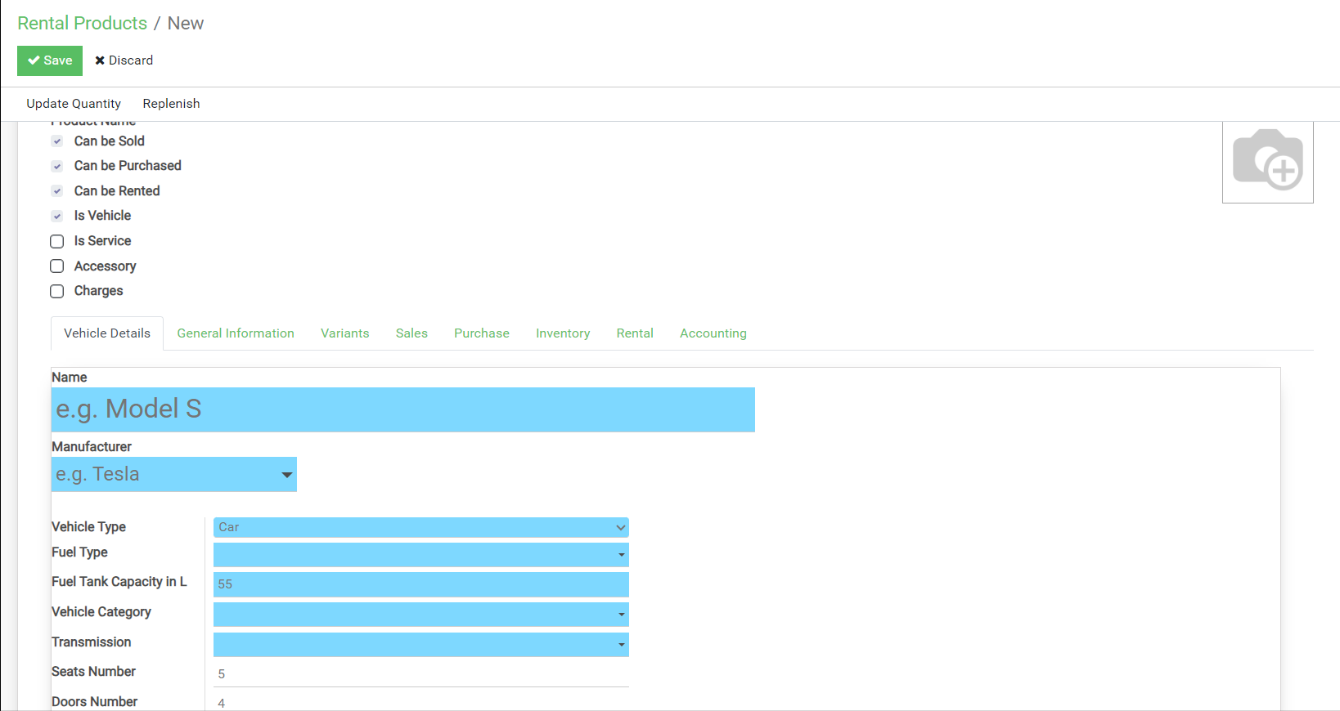
Create Rental Product
Enable Is vehicle check button
A tab Vehicle details will appear fill the vehicle details

Slide 10
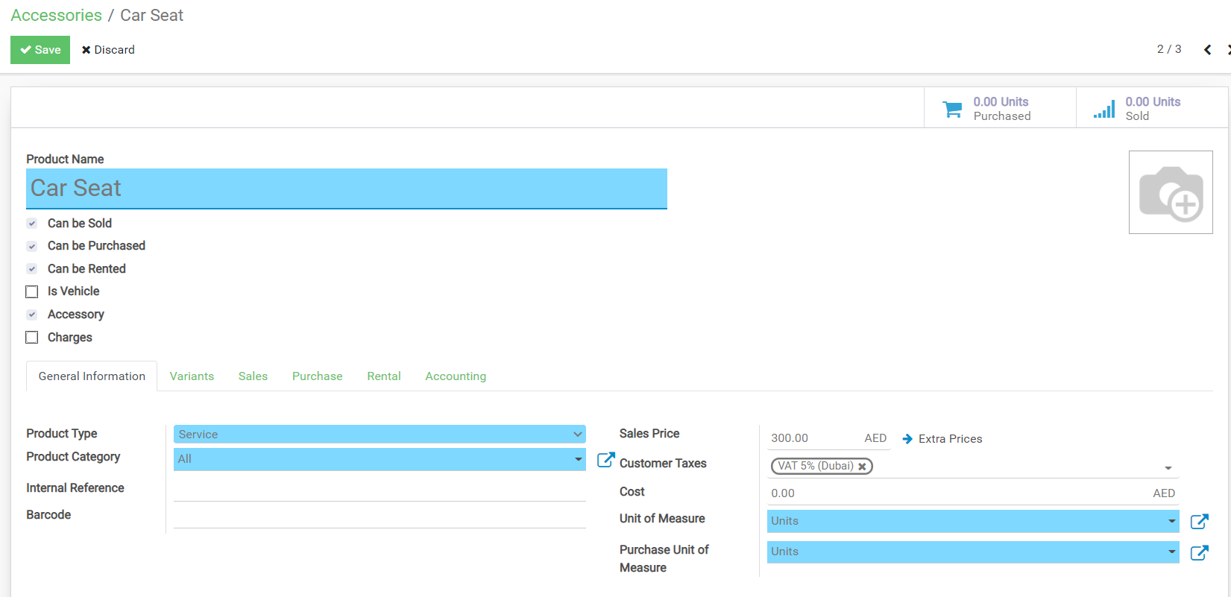
Create Accessories(optional)
Menu
Fleet Rental -> Configuration -> Accessories
If it’s an accessory set Accessories and can be rented

Slide 11
Create Vendors
Menu
Purchase -> Orders -> Vendors
Invoicing -> Vendors -> Vendors
A partner can be a customer / vendor or both at the same time
To create a partner
From the partner creation form select the radio button “Individual” or “Company”
Select “Rental Customer?” if it’s a rental customer
Select “Is Driver” if it’s a driver
From the “Sales & Purchases” tab select “Salesperson” to assign salesman.
Enter the details
Save

Slide 12
Vehicle Purchase operations

Slide 13
Vehicle Purchasing
Creates & Send RFQ
Mentions products, quantity required
Price
PO Issued
Products ,quantity
Scheduled date
Terms
All details in RFQ
Supplier provides quote

Slide 14
Purchasing & Inventory
Receive Goods
Vendor bill generation
Define Unique Serial Numbers for each vehicle
Validate GRN
GRN created from PO
Automated Actions
Analytic accounts created for each vehicle
Vehicles created in the fleet module
Asset document created for each vehicle

Slide 15
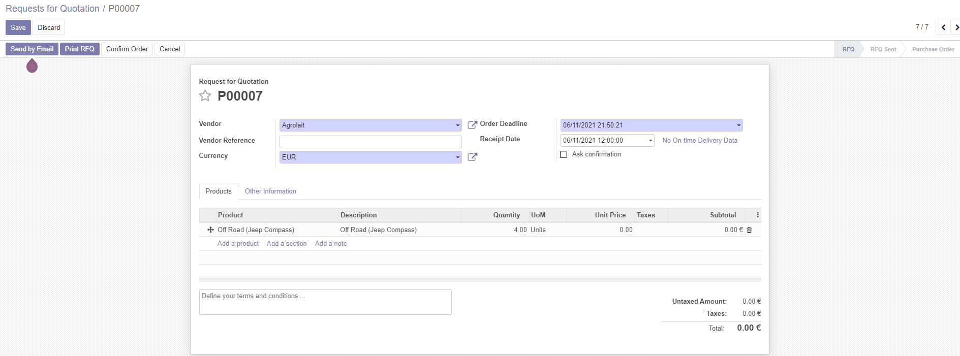
Purchase Vehicles
Menu
Purchase -> Orders -> Requests for quotation
Request For Quotation
Select Vendor
Select “Product(s)”
Enter Quantity & Purchase price
Save
Click on “SEND RFQ BY EMAIL” to send the RFQ to the vendor

Slide 16
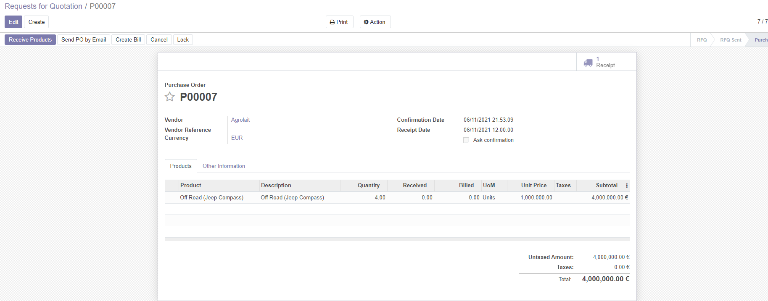
Purchase Vehicles
Purchase Order
Click on “CONFIRM ORDER” to confirm the RFQ to PO
The PO and an GRN in the inventory will be generated

Slide 17
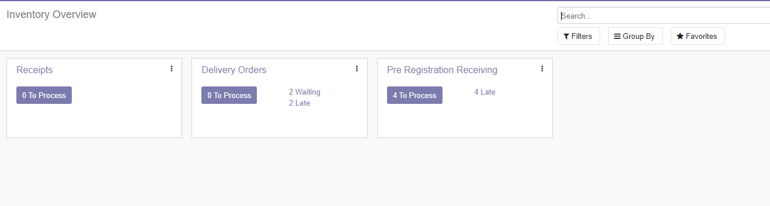
Receive Vehicles
Menu
Inventory -> Dashboard -> Pre Registration Receiving
Pre-Registration Receiving
This card will display the number of GRNs to be received
GRN will be automatically created upon confirmation of PO
Clicking on the blue button will list all the GRNs

Slide 18
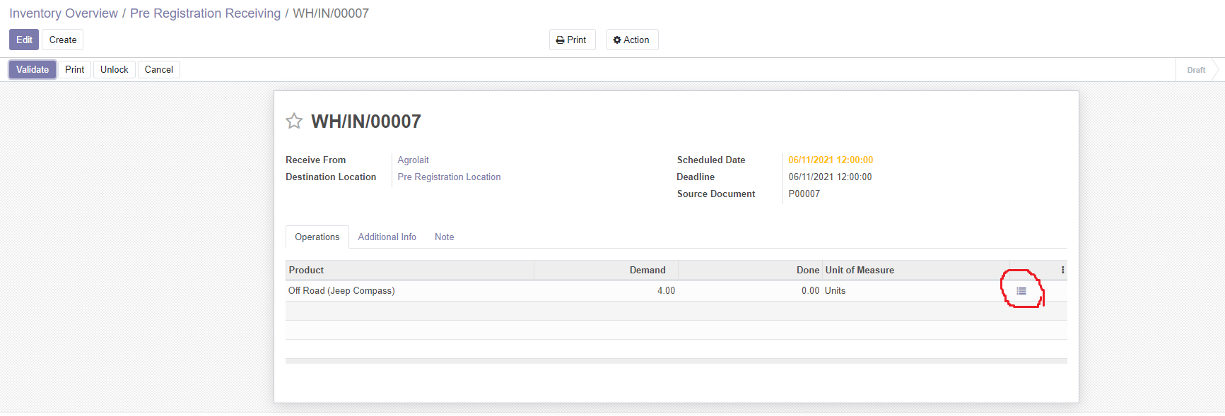
Receive Vehicles
GRN
To record each vehicle in a GRN, click on the 3 lines icon as highlighted
This will open a popup window to enter the unique serial number for each vehicle

Slide 19
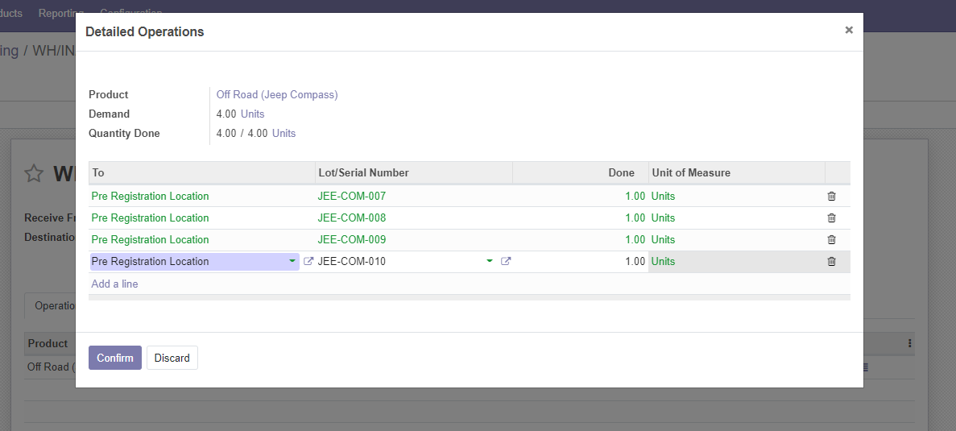
Receive Vehicles
Lot/Serial Number Details
Click on Add an item to open a new line and enter the unique serial number.
Once all the serial numbers(vehicles) are entered then click Confirm

Slide 20
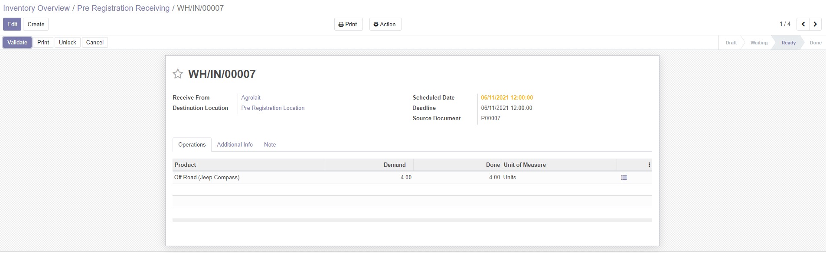
Receive Vehicles
Lot/Serial Number Details
After recording all the serial numbers, Click on Validate. This will perform the below actions.
Change the GRN status to “Done”
Update the delivered quantity in the PO
Create a new vehicle for each serial number in the fleet
Create an analytic account and an Asset document for each vehicle

Slide 21
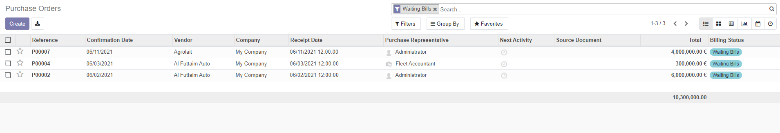
Generate Vendor Bill
Menu
Purchase -> Purchase -> Purchase Orders
All the purchase orders will be listed
Apply “Waiting Bills” in filter section.

Slide 22
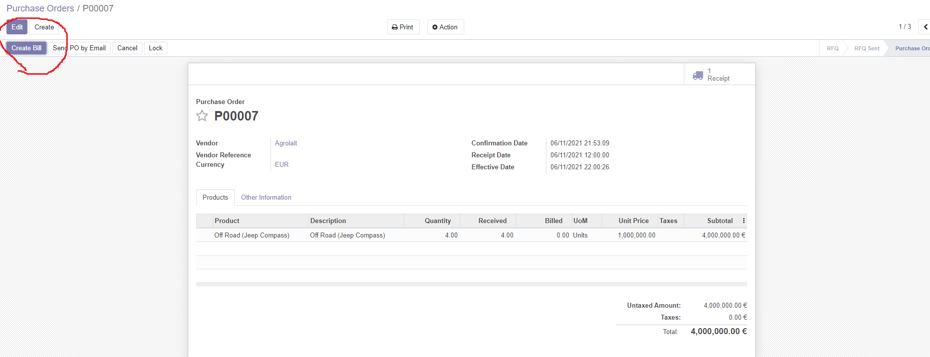
Generate Vendor Bill
PO with “Waiting Bills” status are ready to create vendor bills against them
Open the desired PO and click on the “create Bill” icon as highlighted
The draft vendor bill will be generated

Slide 23
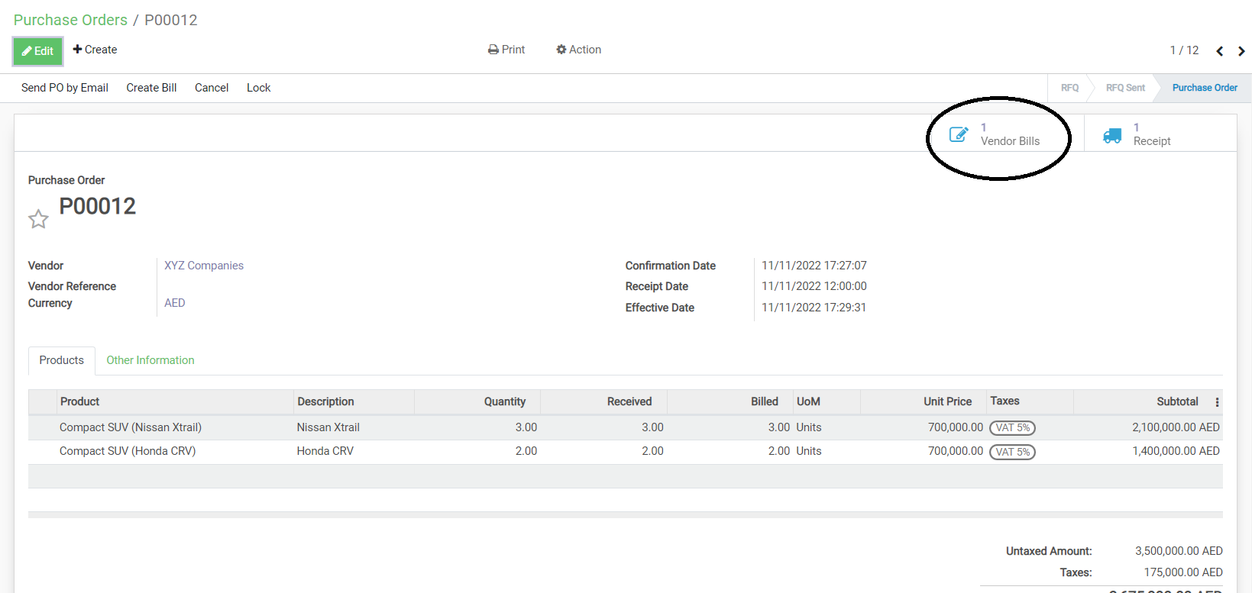
Generate Vendor Bill

Slide 24
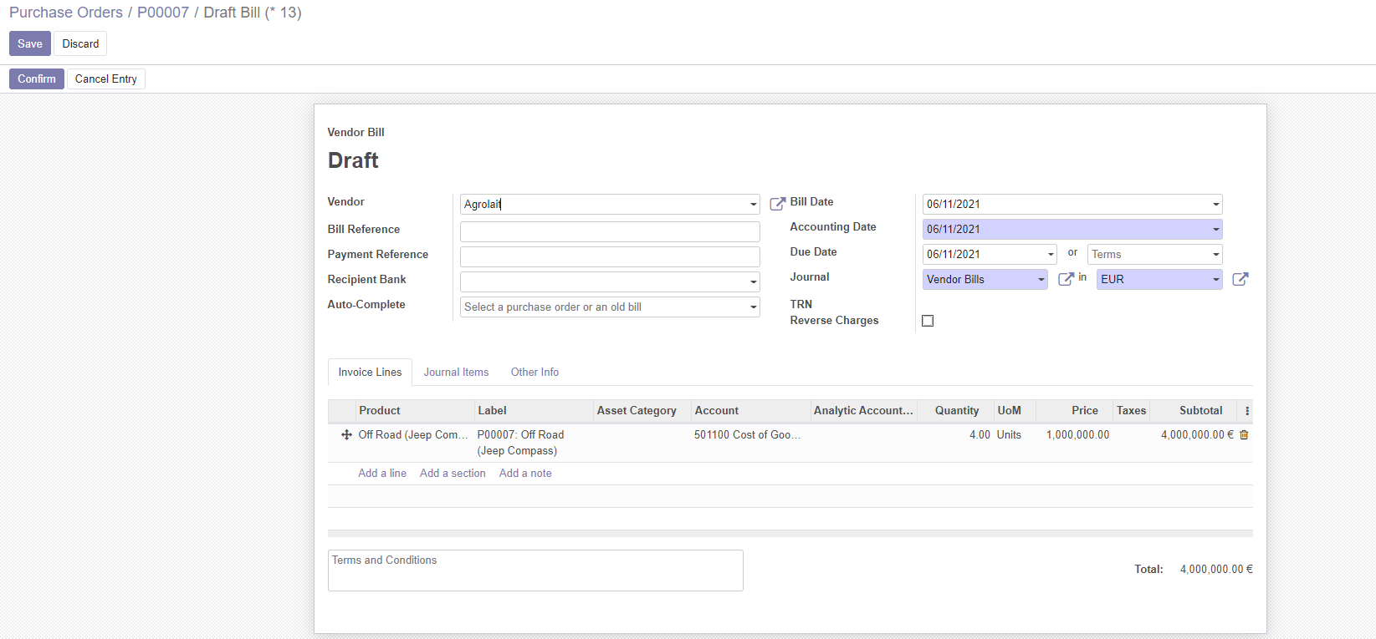
Generate Vendor Bill
Modify the draft vendor bill if required
Confirm

Slide 25
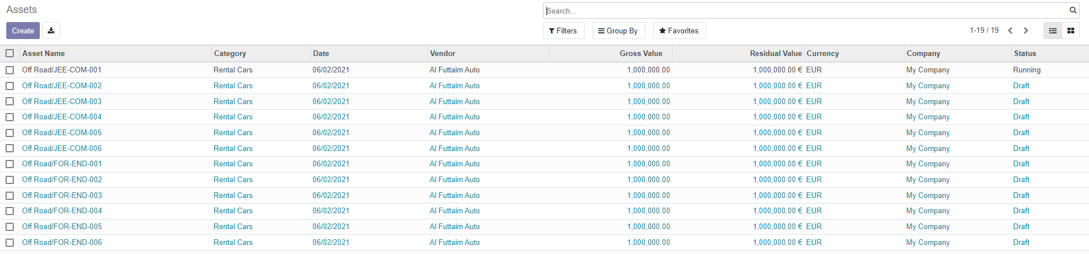
Manage Asset & Loan
Menu
Invoicing -> Accounting -> Assets
Each Vehicle received in inventory will have an asset record created against it automatically.

Slide 26
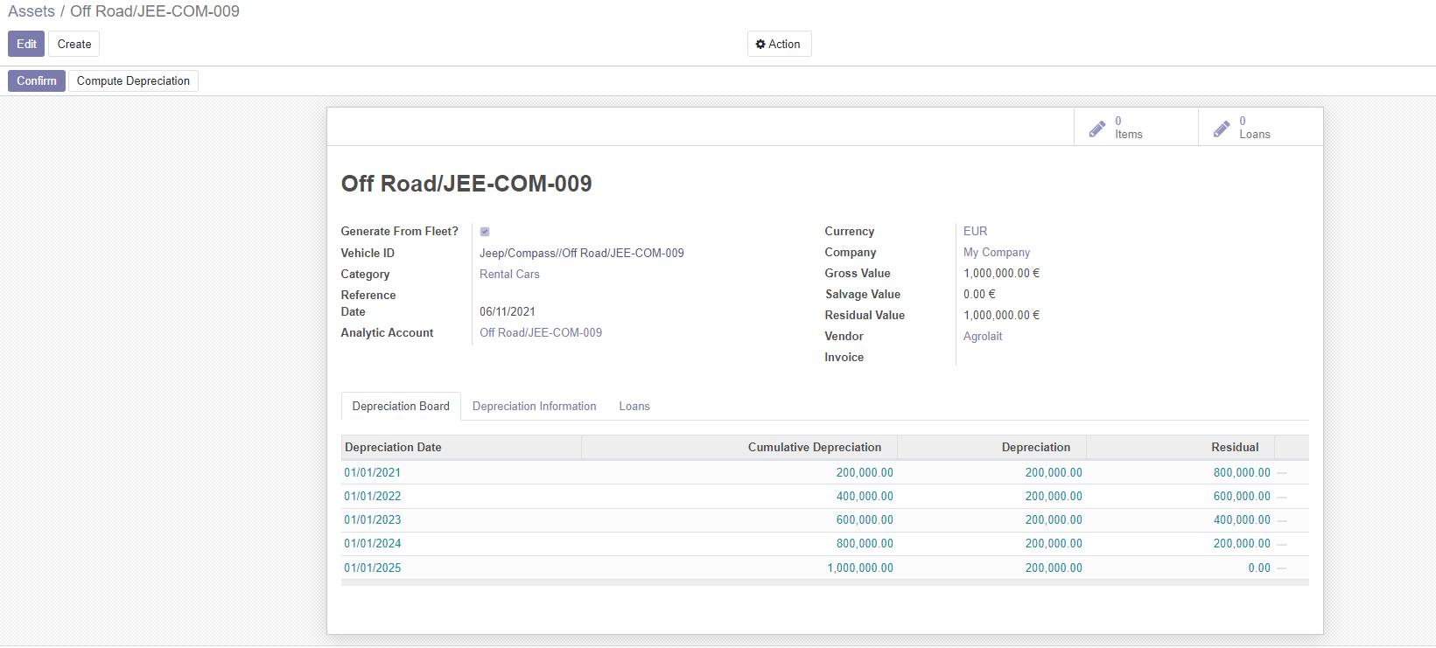
Manage Asset & Loan
From the “Depreciation Board” tab modify the depreciation values if required
Click on confirm
A red dot will appear against each line of depreciation entries. Click on it create a draft journal entry
Clicking on the pencil icon on top right corner will list all the posted & unposted depreciation journal entries

Slide 27
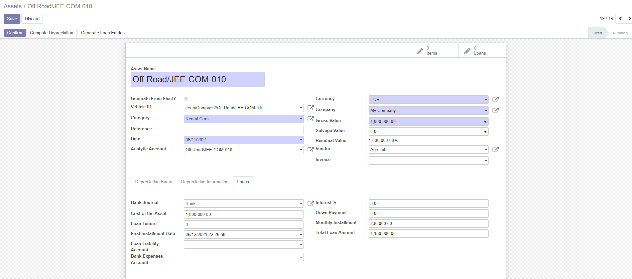
Manage Asset & Loan
From the “Loan” enter the loan details for the vehicle
Click on “GENERATE LOAN ENTRIES”
Clicking on the pencil icon with text “Loans” on top will list all the posted & unposted journal entries for loans
A report for all loans can be generated from Accounting -> Reports -> Loan Reports
All the expenses & Income for a vehicle can be viewed by clicking the “Analytic Account” from the asset form

Slide 28
Vehicle & Sales Management
Vehicle Registration
Vehicle Registration
Close Rental
Create Invoices
Quotation & Rental
Approve Vehicle
Create Quotation
Create Sales Order
Create Rental Contract
Record defects
Record additional Expenses
Receive down payment
Close Rental

Slide 29
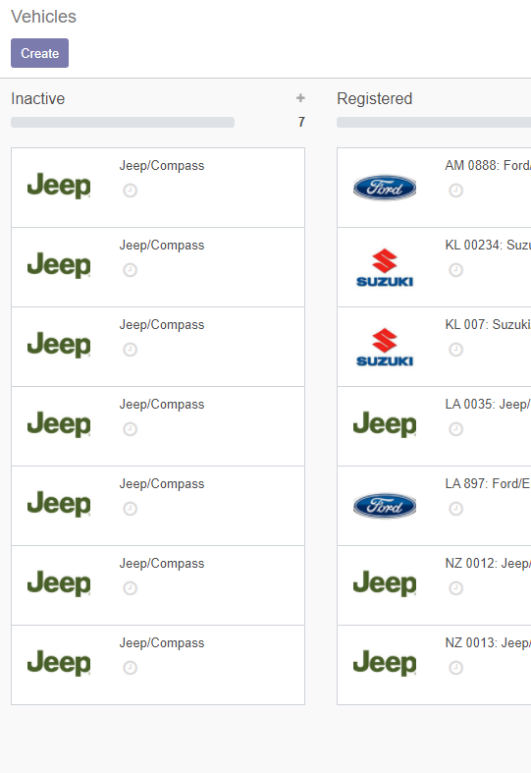
Vehicle Registration
Menu
Fleet Rental-> Vehicles -> Vehicles
Each Vehicle received in inventory will appear here for registration

Slide 30
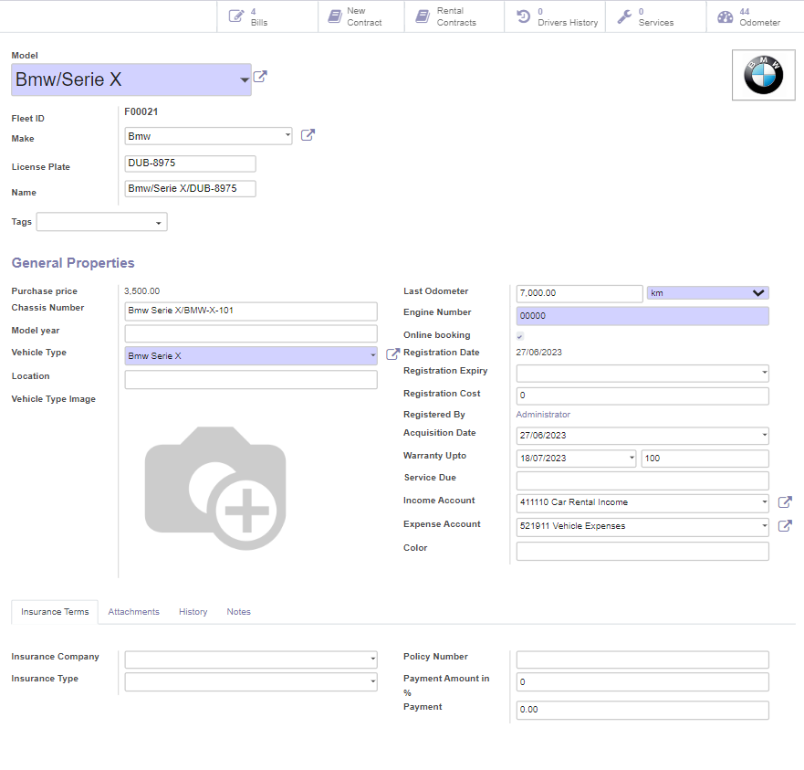
Vehicle Registration
Key Points
Make, Model, Model No, Last Odometer & License Plate
Enter License plate no
“SUBMIT FOR APPROVAL” will ask the fleet manager’s approval to add the vehicle to rentable vehicles list
Once submitted, the state of vehicle will change to Registered

Slide 31
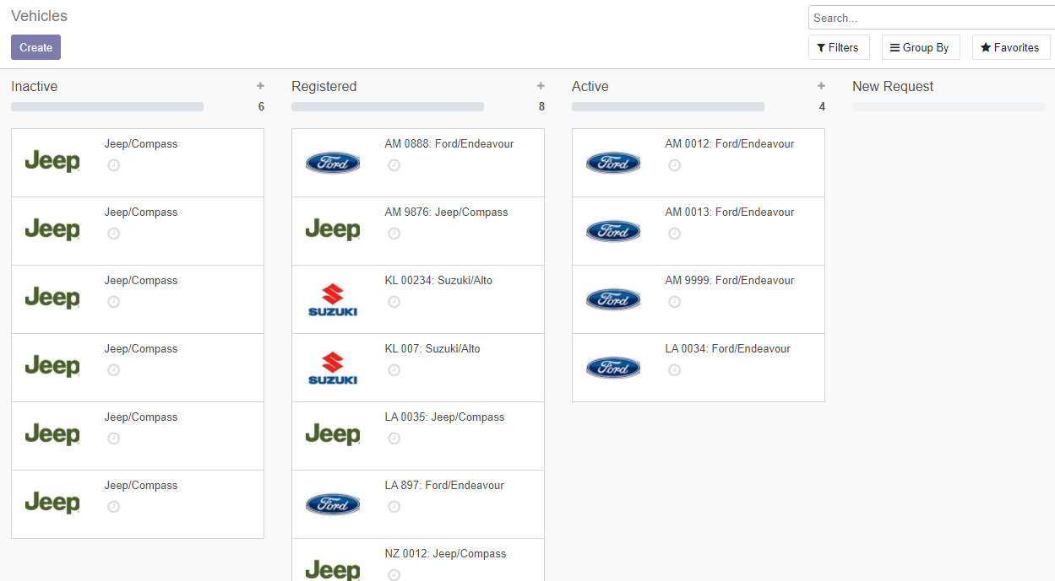
Approve Vehicles
Menu
Fleet Rental-> Vehicles -> Vehicles
Approval Waiting vehicles are listed below “Registered”
Click on the vehicle from registered state
Click Approve
Once submitted, the status will change to “Available”. Means vehicle is available to rent

Slide 32
Vehicle Rental Operations

Slide 33
Create Customers/Drivers
Menu
Fleet Rental-> Rental Management -> Customers
Sales -> Orders -> Customers
Invoicing -> Customers -> Customers
To create a Customer/Driver
From the partner creation form select the radio button “Individual” or “Company”
Select “Is Driver” if it’s a driver
From the “Sales & Purchases” tab select “Salesperson” to assign salesman.
Enter the details
Save

Slide 34
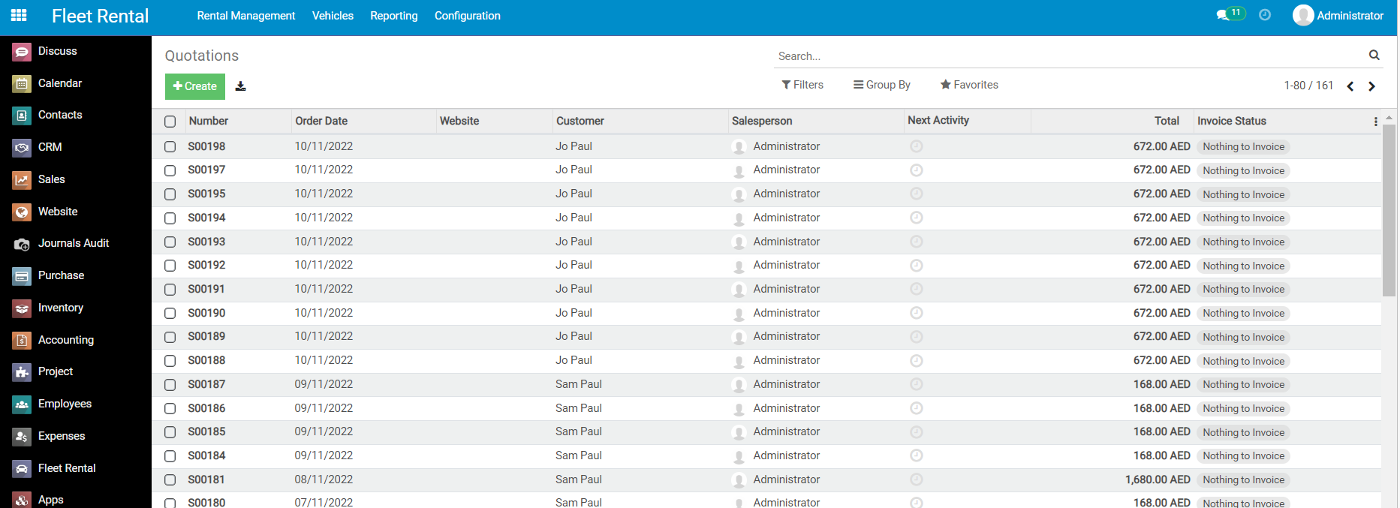
Create Quotation
Menu
Fleet Rental-> Rental Management -> Quotations

Slide 35
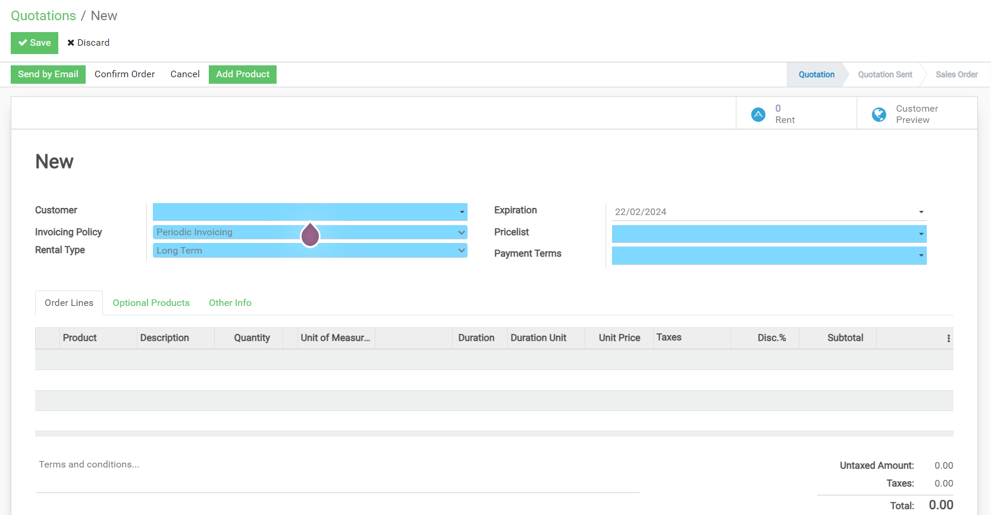
Create Quotation
Select Customer
Select Rental Type
Click on “Add PRODUCT” to add product

Slide 36
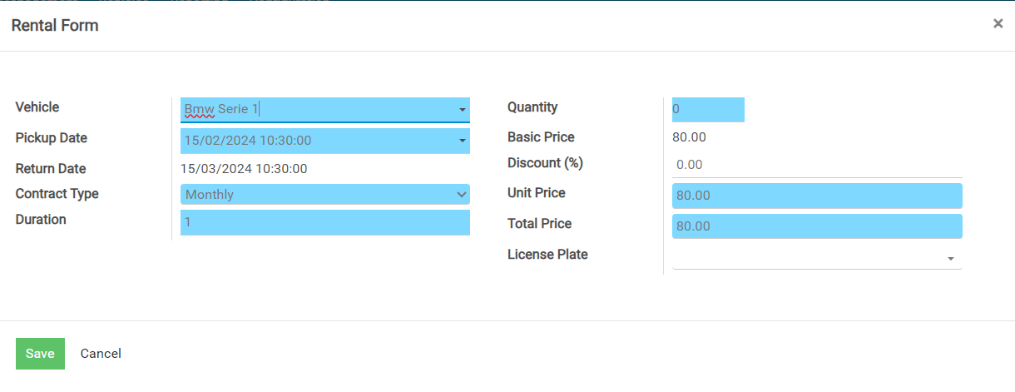
A popup window will appear
Select Vehicle, Pick Up date, Duration Unit, Duration, Quantity, License Plate(s)
We can give New unit price
Save

Slide 37
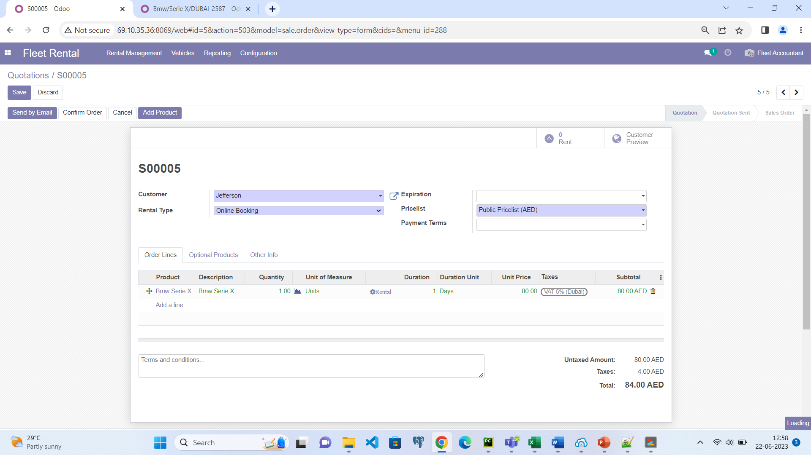
Create Quotation
Quotation form will get populated with selected rental options
To send the quotation to the customer, click on “SEND BY EMAIL”

Slide 38
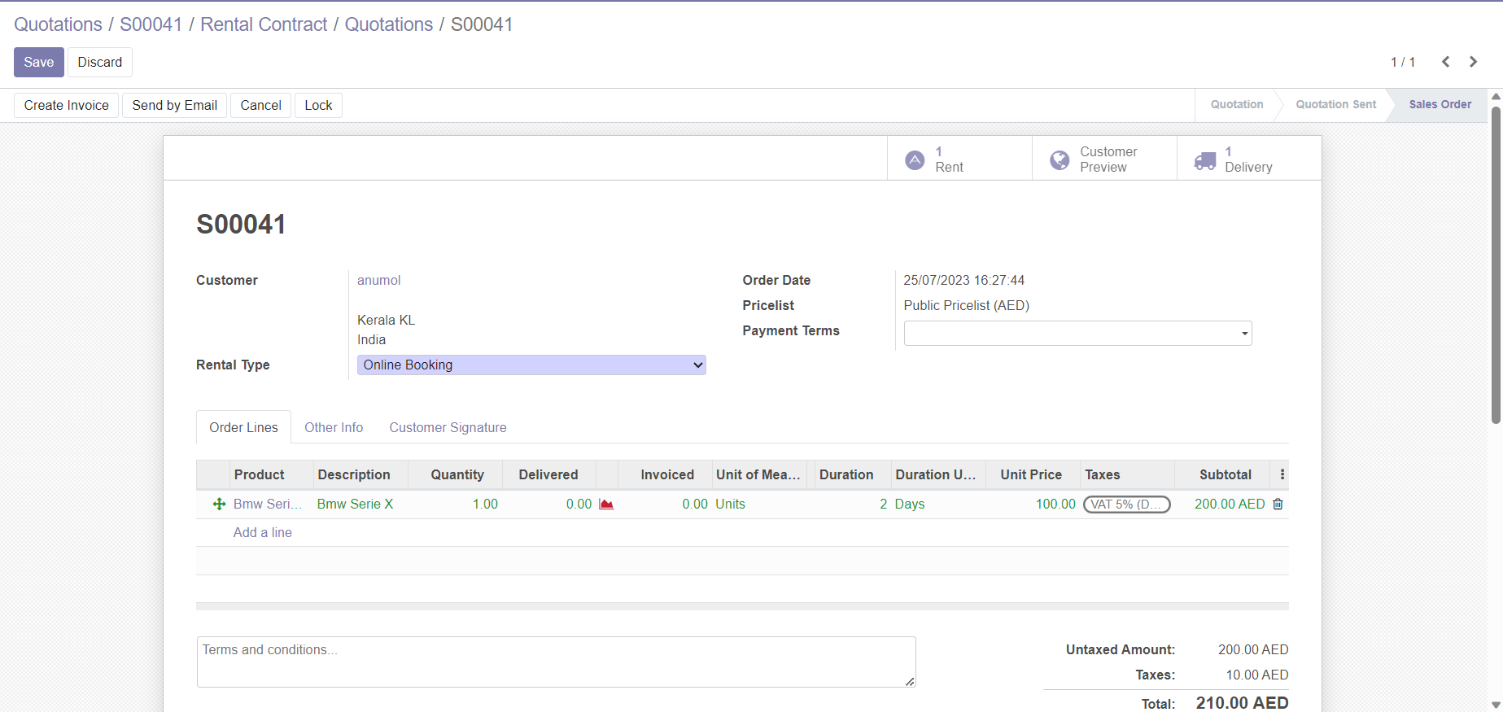
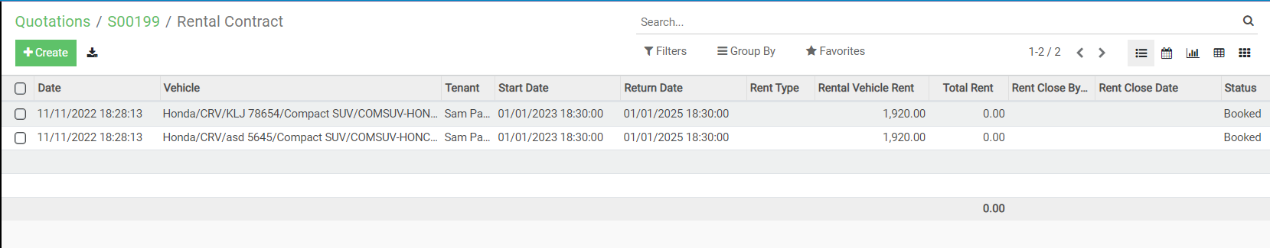
Confirm Sale Order
Once confirmed, status of the document will change to “Sales Order”
Rental booking will be created against each serial number selected.
The bookings can be viewed by clicking the icon which says “Rent” on top right corner

Slide 39
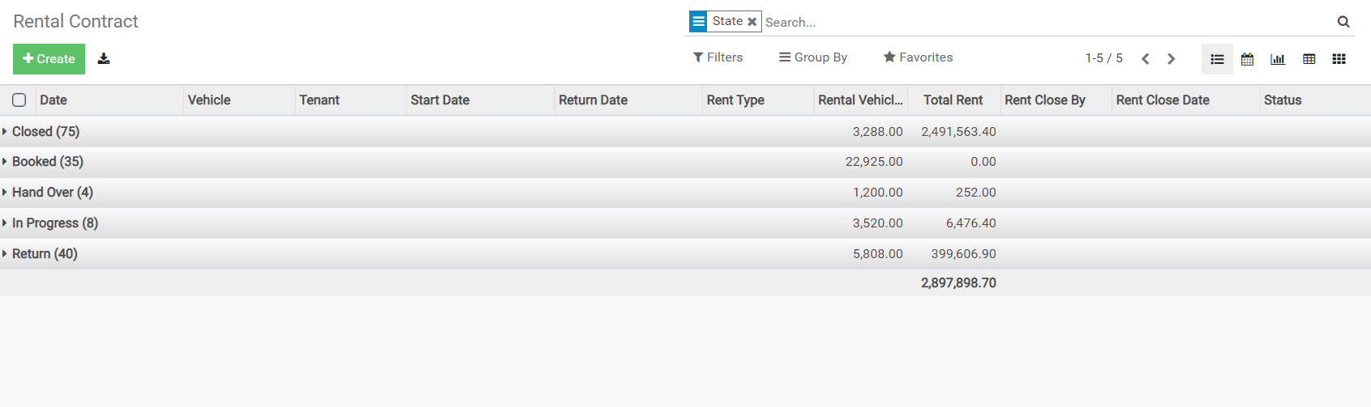
View Rentals
Menu
Fleet Rental -> Rental Management -> Rental Contract
All rentals will be listed here

Slide 40
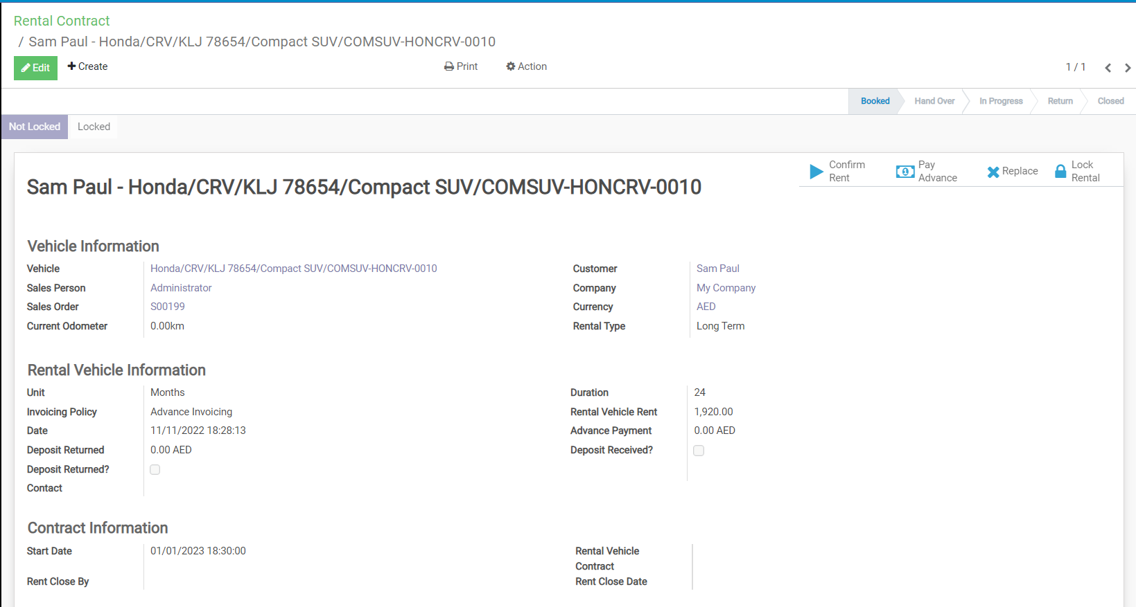
Confirm Rental Contract
Key Points
Select invoicing policy

Slide 41
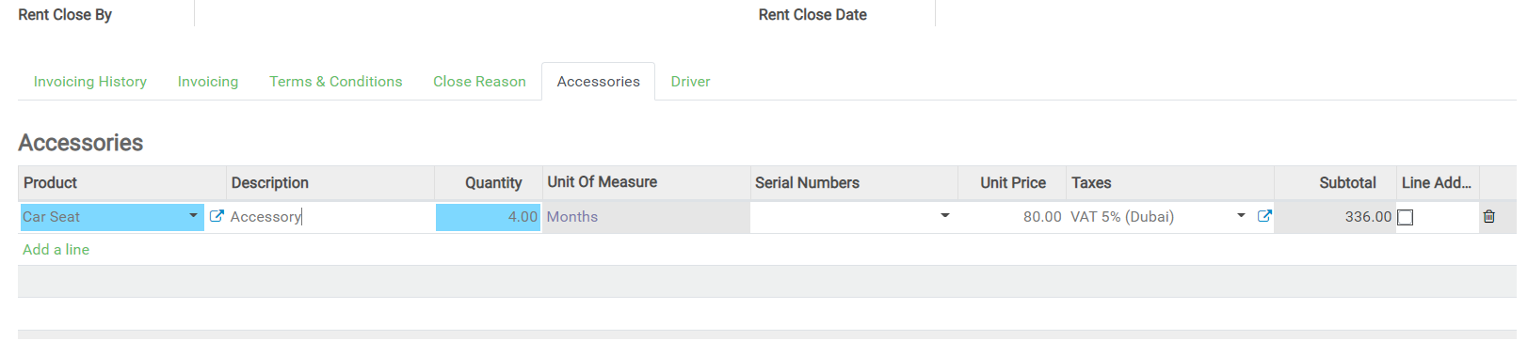
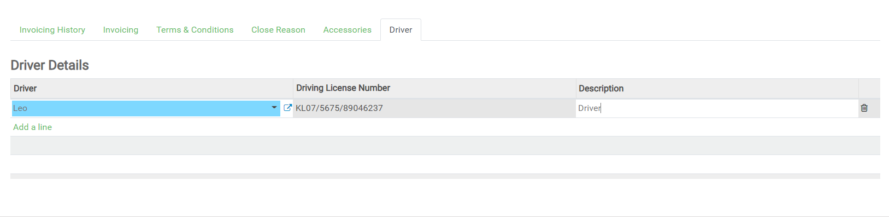
Enter Accessories by Clicking “Accessories” tab
Enter Driver Details by Clicking “Drivers” tab if customer is not a driver

Slide 42
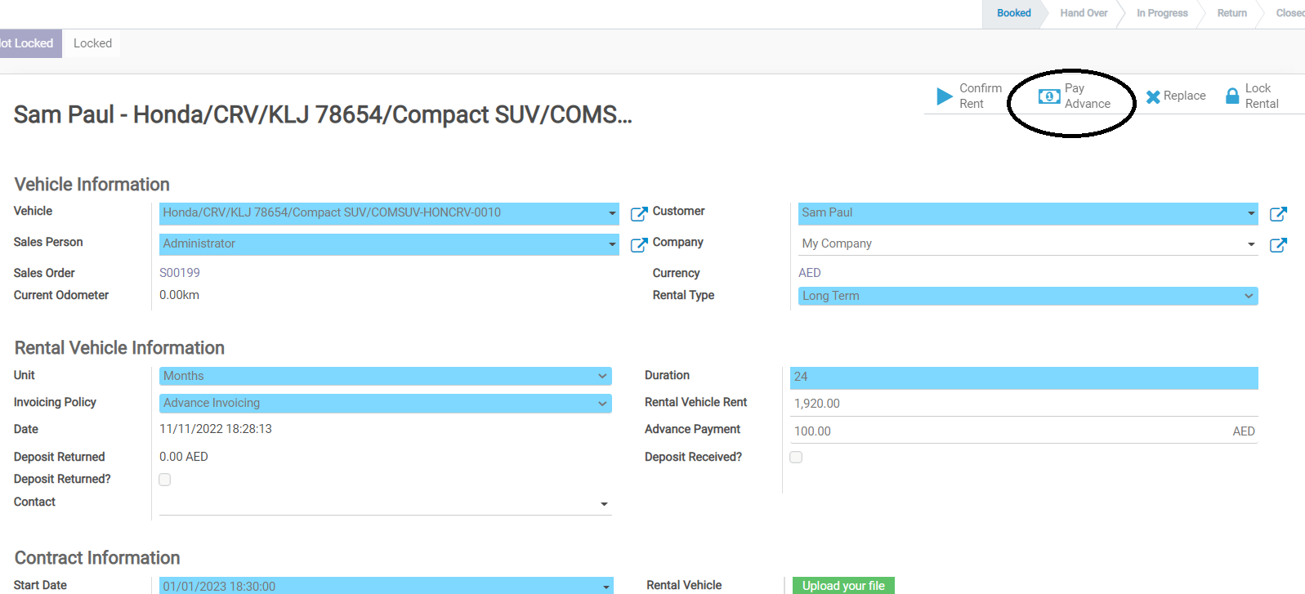
Confirm Rental Contract
Click on Pay Advance button

Slide 43
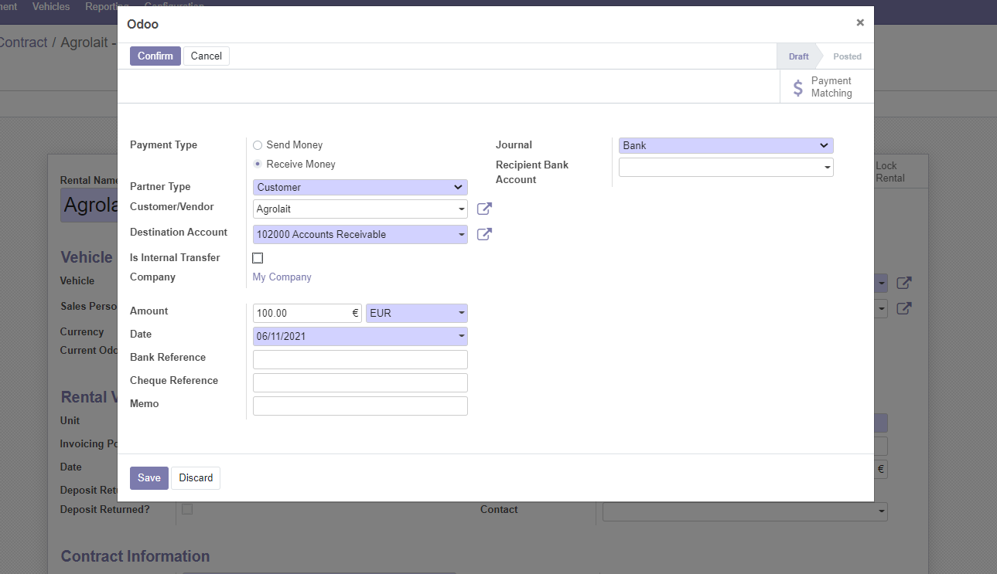
Confirm Rental Contract
Enter the details
Confirm

Slide 44
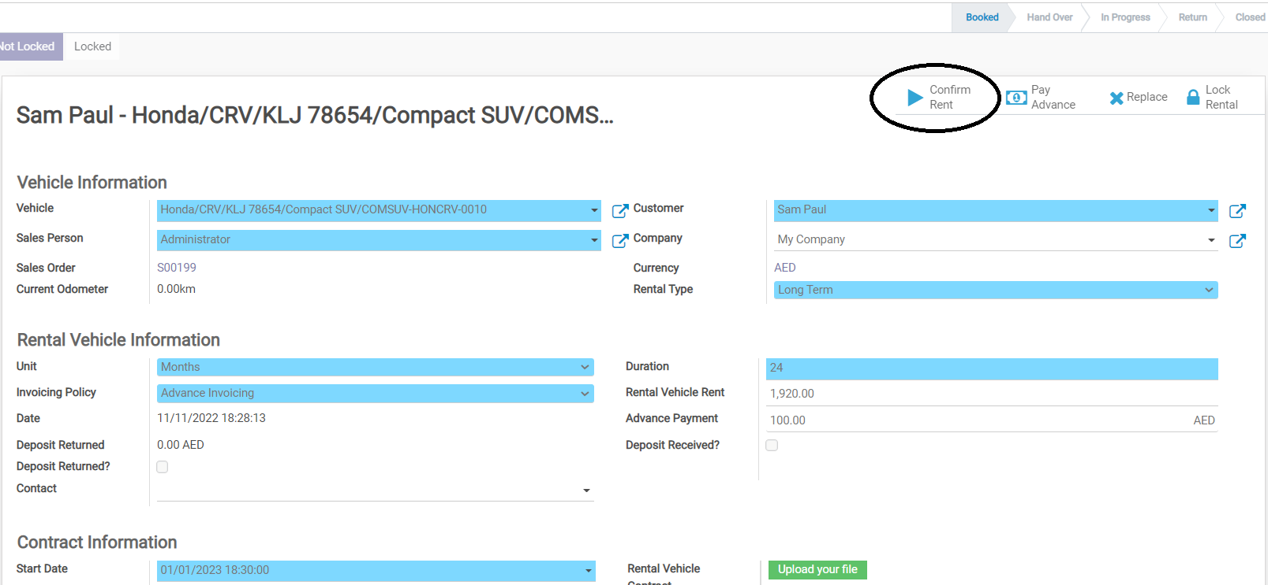
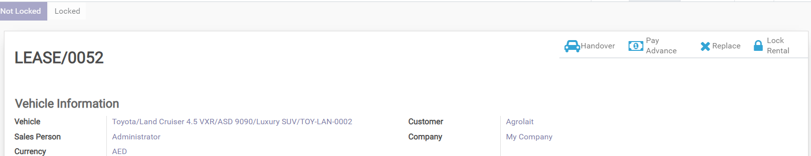
Confirm Rental Contract
Click on “Confirm Rent” button to start the rental contract
A new button ‘Handover’ will appear, and rental sequence is created

Slide 45
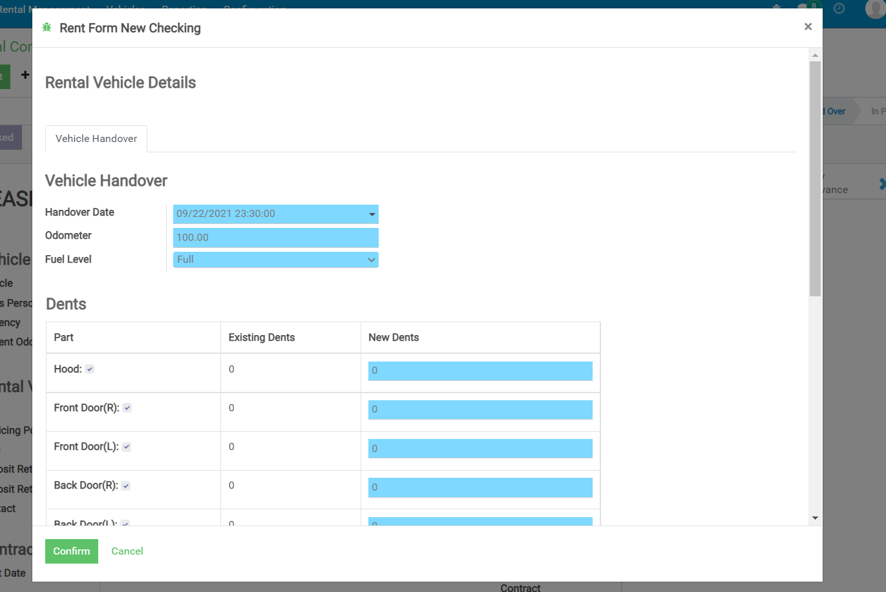
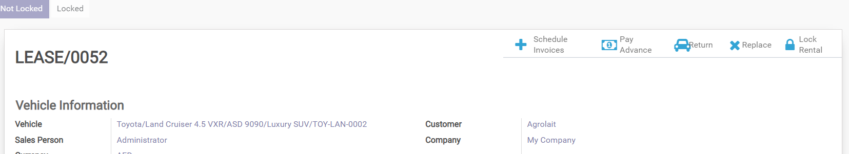
Enter Handover date, odometer, fuel level, and dents
Confirm
A new button schedule invoices appear

Slide 46
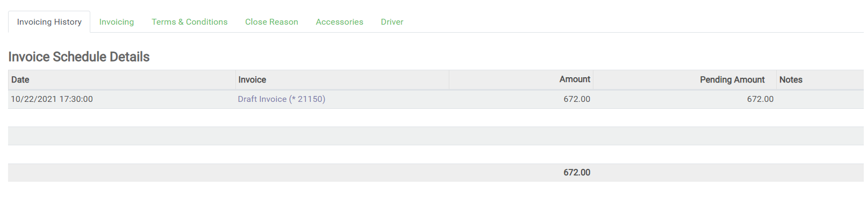
Generate Invoices
Draft Invoices will be generated as per the selected invoicing policy
User can regenerate the invoice schedules if none of the invoices are validated
To validate an invoice, click on the invoice line highlighted. This will open the invoice form

Slide 47
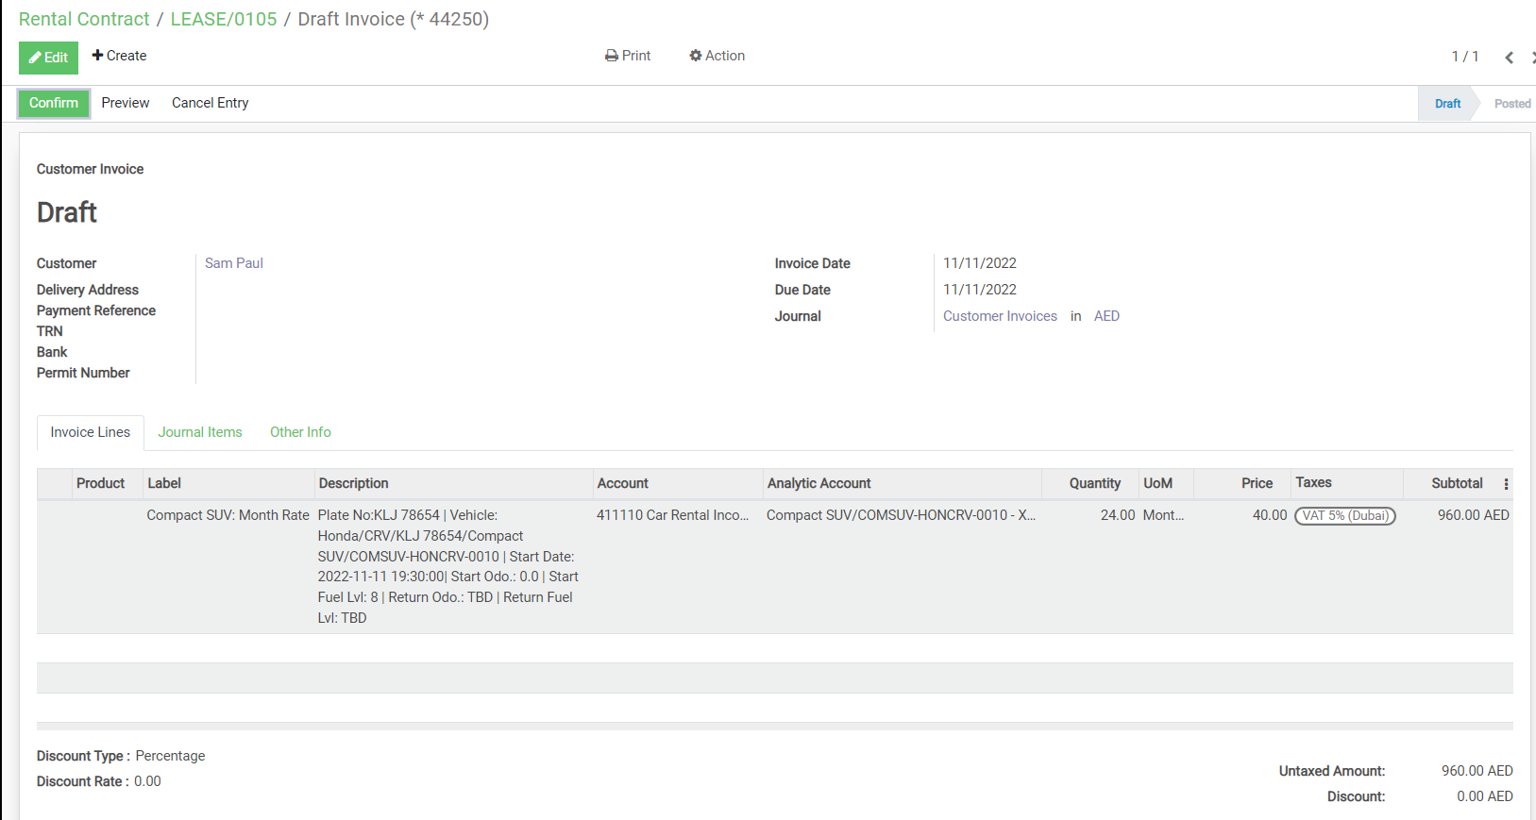
Validate Invoices
Click on “Confirm” button

Slide 48
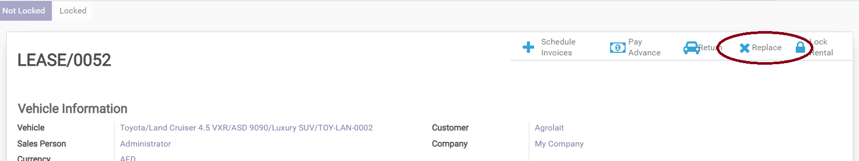
Replace Vehicles
User can replace the vehicle on rental contract by clicking the “Replace” button as highlighted
This will open a popup window

Slide 49
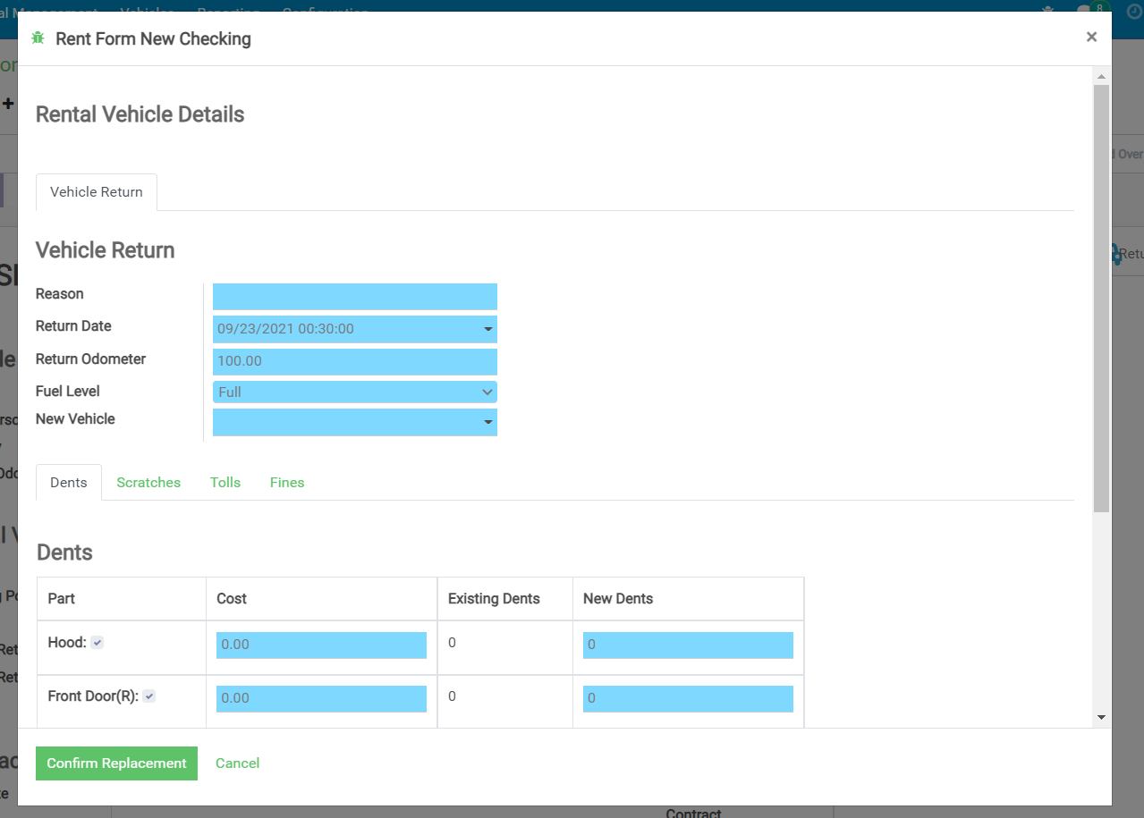
Replace Vehicles
Enter the Reason, Return Date, Return Odometer, Fuel Level, New vehicle to replace, Dents , scratches, Tolls and Fines From the wizard
Confirm Replacement

Slide 50
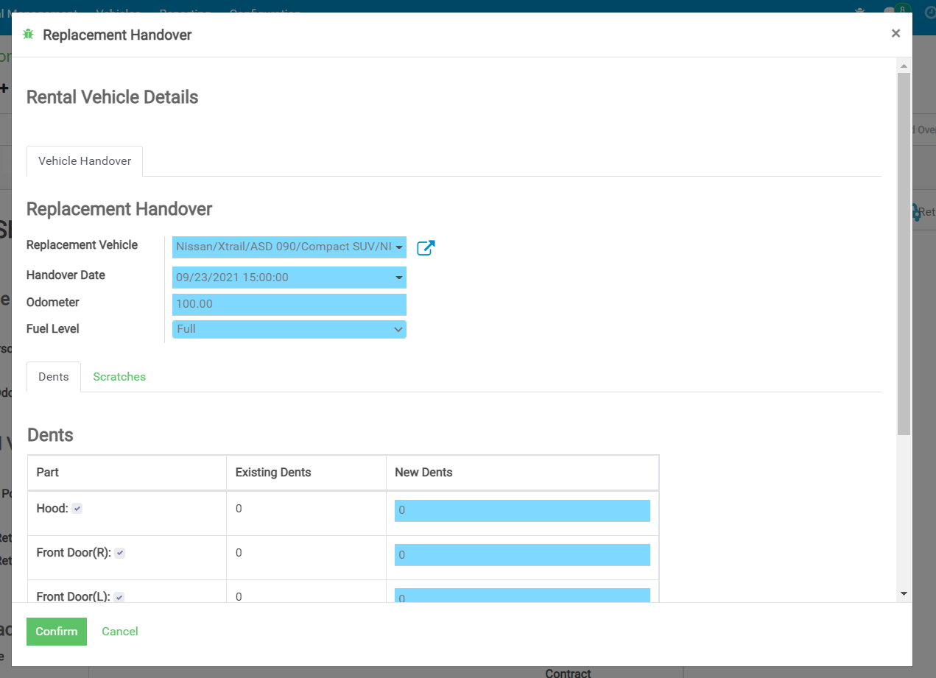
Replace Vehicles
From the form select the Replacement vehicle, Handover date and time, Odometer, Fuel Level, Dents and Scratches
Click Confirm
This will replace the vehicle in the rental contract & change the status of previous vehicle as per the replacement reason

Slide 51
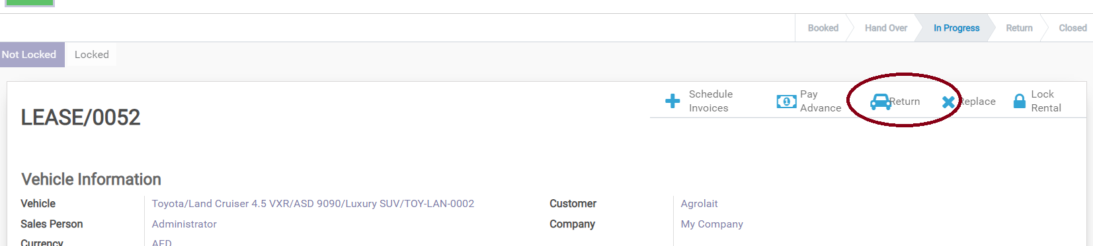
Return Vehicle
User can Return the vehicle on rental contract by clicking the “Return” button as highlighted
This will open a popup window
Enter the Reason, Return Date, Return Odometer, Fuel Level, Dents, Scratches, Tolls and Fines

Slide 52
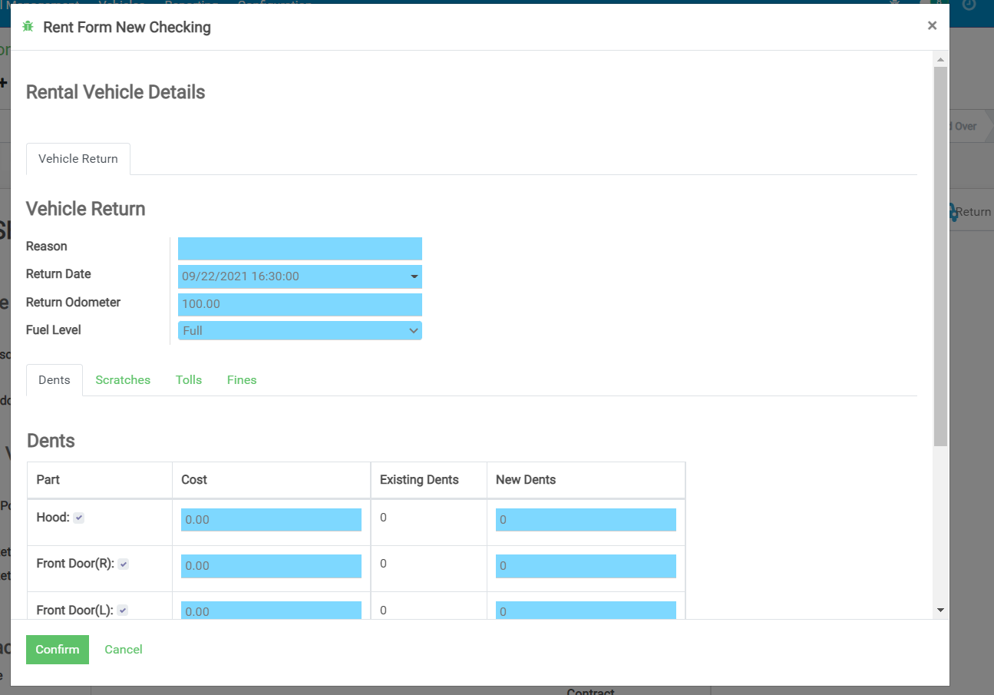
Return Vehicle
Confirm

Slide 53
Return Vehicle
In the rental returning form user can enter the details as shown in the above form
Based on the Rental if there is any additional charges and rental terms in long term, short term or online booking User will get an option to create invoices for those charges
If rental terms is spot invoice automatically created when we confirm the rent. Additional charges added to the invoice if it’s not confirmed otherwise new invoice created.
User can still create any additional invoice after closing the rental as well.
If the rental contract is locked, then the user will not be able to create any new invoices or modify the contract parameters

Slide 54
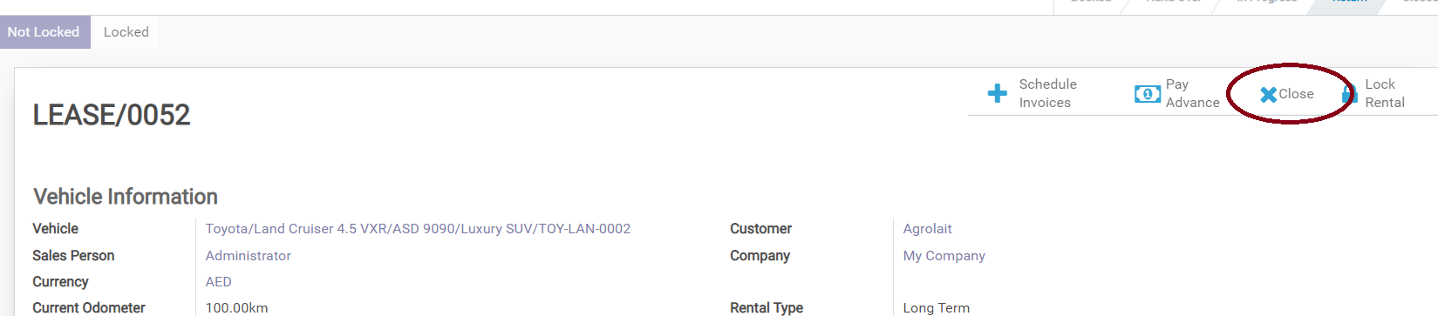
Close Rental
To close a renal contract , click on the “Close” button as highlighted
This will open a popup window

Slide 55
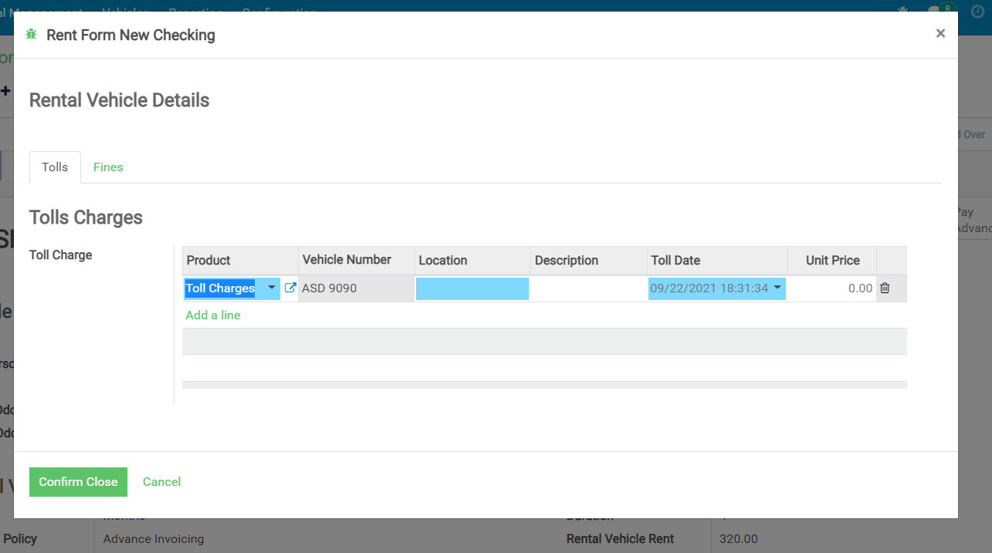
Close Rental
Enter Tolls and Fines
Confirm Close

Slide 56
Close Rental
In the rental closing form user can enter the details as shown in the above form
Based on the details if there is any additional charges, There will be two options.
User will get an option to create invoices for those charges and close the rental
Or Close the rental without invoicing the customer for any additional charges
User can still create any additional invoice after closing the rental as well.
If the rental contract is locked, then the user will not be able to create any new invoices or modify the contract parameters

Slide 57
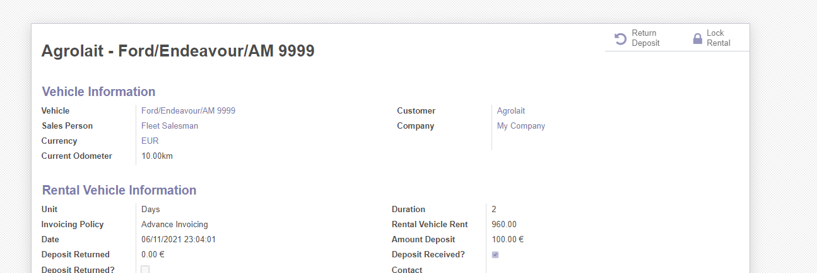
Lock Rental
Menu
Fleet Rental -> Rental Management -> Rental Contract Open the contract to be locked
To lock a renal, click on the “Lock” button as highlighted
Once a rentals locked then the user will not be able to modify / invoice the contract.
Managers have the access to unlock a locked rental

Slide 58
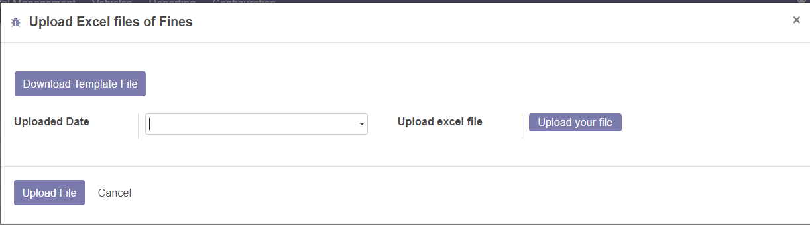
Upload Excel Files of Fines
To Edit and Upload Excel sheet of Fines
Go to Fleet Rental → Configurations → Excel File of Fines.
A wizard will appear

Slide 59
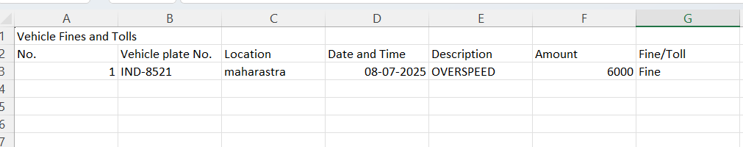
Upload Excel Files of Fines
First Click Download Template File edit the data
Click on Upload your file
Click on Upload File to update the data

Slide 60

Manage Sales Team
Menu
Fleet Rental -> Rental Management -> Sales Team
Each Salesman should be a user in the system
Commissions will be generated based on the payment
To create a new salesman, click on “CREATE”

Slide 61


Manage Sales Team
Define Commission % and select the user correspond to the salesman.
Customers will be auto populated as assigned in the customer form
From Accounting tab select the relevant accounts

Slide 62
Vehicle Maintenance

Slide 63

Start Maintenance
Menu
Fleet Rental -> Rental Management -> Vehicles
Fleet Rental -> Vehicles -> Repair/Maintenance
To record a maintenance, Open the Vehicle form and click on the Services button
Or Create from Fleet Rental -> Vehicle -> Repair/Maintenance
Click On Create.
Fleet Assistant can only create draft services.

Slide 64

Start Maintenance
Or Create from Fleet Rental -> Vehicle -> Repair/Maintenance
Click On Create.
Fleet Assistant can only create draft services.

Slide 65

Confirm Maintenance
Fleet Manager can confirm the maintenance to start
Enter the expected completion date (“ETIC”)
Add Repair types ( If any)
Click on ‘GENERATE BILL” to create vendor bill

Slide 66

Select Workshop

Slide 67

Draft Bill/Vendor Bill
Clicking on ‘GENERATE BILL’ draft bill will be created
Click ‘CONFIRM’ to generate ‘VENDOR BILL’

Slide 68

Click ‘REGISTER PAYMENT’ a pop up form will be created for ‘CREATE PAYMENT’

Slide 69

‘CREATE PAYMENT’ will generate finalized maintenance bill.

Slide 70


Slide 71

Close Maintenance
Once the maintenance is over click on “Close”
If any of the repair types have not completed the system will show below warning
To Proceed, user can confirm

Slide 72
END

Slide 73
User Roles & Actions
# | User Role | Features
1 | Fleet Assistant | 1. Vehicle Registration 2. Request / Service Maintenance 3. Receive Vehicles in inventory
2 | Fleet Manager | All features of fleet assistant + 1. Approve Vehicle Registration 2. Approve Service / Maintenance 3. Create vendor bills for services
3 | Salesman | 1. Add inquires 2. Send Quotes 3. Confirm order 4 . Create Booking & rentals 5.Create draft Invoices 5.Mark Damages & capture additional expenses occurred by customer 5. Close Rentals
4 | Sales Manager | All features of salesman + 1. Manage Sales team 2. Lock & Unlock Rental Orders
5 | Accountant | All of the above + 1 .All accounting operations 2. Create Products 3. Create Vehicles 4. Loan Management 5. Asset Management 6. Create & approve PO

